Slide 1
Module 1- Basics of Technical English

Slide 2
After Studying this Module you will be able to know
Technical English: Definition; Extent& Coverage; Dimensions Reading; Skimming; Scanning; Churning & Assimilation
Writing: Methods: Inductive; Deductive; Exposition; Linear; Interrupted; Spatial & Chronological etc
Technical Communication; Approaches: Brevity; Objectivity; Simplicity; Utility & Clarity
Listening: Active; Passive; Thinking strategies: Positive & Logical thinking; Speaking: Essentials Nuances & Modes of Speech Delivery.

Slide 3
What is communication?
“COMMUNICATION IS THE KEY”
Look around and you will find people involved in several activities, which involve
Informal conversations
Meetings
Presentations
Phone calls
Tele-conferencing
Video-conferencing
Gossiping
Net surfing
Chatting and so on….

Slide 4
What is communication? Contd…
In short, we need to communicate in order to interact. Communication is one of the essential conditions of social interaction; it plays a key role in our life.
Now let us try to understand what the term ‘communication’ means. The term has been defined
at various levels.
The word communication comes from the Latin word communicare, meaning ‘to share, to impart, or to commune (to share your emotions and feelings with someone without speaking).
It’s literal meaning is ‘giving or sharing information’.

Slide 5
Nature of Communication
(i) Transmission of subject-matter or message
(ii) Involvement of two parties to complete the process of communication
(iii) The person to whom the message is transmitted understands it in the same sense in which the sender of message wants him to understand it

Slide 6
Purposes of Communication:
i. To inform
ii. To reassure
iii. To teach
iv. To deliver news, whether good or bad
v. To understand
vi. To explain
vii. To persuade
viii. To transact
ix. To organize
x. To control
xi. To co-ordinate
xii. To direct

Slide 7
Communication Process / Stages of Communication / Communication Cycle
As we know, communication is a dynamic interactive process. It consists of five steps, that is:
1) Ideation
2) Encoding
3) Transmission
4) Decoding
5) Feed back / Response

Slide 8
Sender has an idea
Sender Converts the idea idea into words
Messages Travels over the channel
Receiver Responds
Receiver decodes message
Ideation
Encoding
Transmission
Decoding
Feedback
Sender
Receiver

Slide 9
Communication Process / Stages of Communication / Communication Cycle
Ideation:
Process of communication begins with ideation which refers to the formation of idea or selection of message. It consist of 'what ‘ communication and is concerned with the content the specific message to be presented . The scope of ideation is generally determined by the sender’s :
Knowledge
Experience
Abilities
Purpose of communication
Context of the communicative situation
Messages generally have two kinds of content
Logical – Such messages consist of factual information.
Emotional – Such messages consist of feelings and emotions.

Slide 10
2) Encoding:
It is the second step in communication. It is the process of changing the information into some form of logical and coded message. It involves –
Selecting a language
Selecting the right language is essential for effective coding, verbal messages need a common language code, which can be easily decoded by the receiver.
b) Selecting a medium of communication
It involves making the right choice out of many available options. There are three basic options for sending interpersonal messages i.e. speaking, writing and non-verbal signs & symbols (body movements, facial expressions, touching patterns, speech mannerisms).

Slide 11
c) Selecting an appropriate communication form
Selection of the appropriate communication form largely depends on the sender – receiver relationship, and need and purpose of the communication. Various communication forms can be –
Interpersonal face to face communication.
• Group Communication
• Speaker – audience communication
• Telephonic Communication
• Written Communication (Reports, Proposals, Memos, Letters, Emails etc.)

Slide 12
Transmission
It refers to the flow of message over the chosen channel. It involves choosing the
Proper time (When to communicate)
Proper place (Where to communicate)
Proper way (How to communicate)
Channels of transmission can be internet, fax, telephone, courier service, Television, etc.

Slide 13
Decoding
Decoding is the process of converting a message into thoughts. It is important to note that it is the message that is transferred, as meaning can not be transferred from one person to another. The receiver has to assign meaning to a message in order to understand it. The process of decoding involves interpretation and analysis of a message. Decoding involves reading and understanding of the written communication and listening and understanding of the oral communication.

Slide 14
Feed back / Response
Response is the last stage in the communication process. It is the action or reaction of the receiver to the message. Response is the key to communication. It helps the sender know that that message was received and understood.

Slide 15
NOISE
Noise is a variety of sound. It means any unwanted sound. Sounds, particularly loud ones, that disturb people or make it difficult to hear wanted sounds, are noise.
For example, conversations of other people may be called noise by people not involved in any of them; any unwanted sound such as dogs barking, neighbours playing loud music, road traffic sounds, or a distant aircraft in quiet countryside, are noise.

Slide 16
Types of Noise:
Physical Noise
Sometimes the biggest impediment to clear communication is everyday environmental noise. This can include loud passersby, music (think talking over a band at a concert), traffic or children playing. Even a simple phone ringing can distract a listener so that she cannot fully focus on a conversation. Other physical conditions that can hinder communication are physical illness, being under the influence of drugs or alcohol, or being tired.
Semantic Noise
Semantic noise affects communication when people communicate from different playing fields. In other words, they are working from different understandings, such as different primary languages, dialects or basic cultural characteristics. Poor handwriting and using slang can also be semantic noises that complicate effective communication.

Slide 17
Psychological Noise
Psychological noise can be more difficult to define in a particular situation, as the mental makeup of every person is different. This type of noise includes concepts like prejudices, narrow-mindedness and personal bias. Communication can also be difficult if a person is feeling very emotional -- anger, sadness and even joy can affect how much someone can pay attention to a conversation or lecture.

Slide 18
Levels of Communication
Human communication takes place at various levels:
1) Extra-personal
2) Intra-personal
3) Inter-personal
4) Organizational
5) Mass Communication

Slide 19
Extra-personal communication:
Communication between human beings and non-human entity is known as extrapersonal communication. For example, when your pet dog comes to you wagging its tail as soon as you return home from work, it is an example of extra-personal communication. i.e. communication between pets (dogs, monkeys, parrot) and their masters.
More then any other form, this form of communication requires perfect coordination and understanding between the sender and the receiver because at least one of them transmits information or responds in signs language only.

Slide 20
Intrapersonal Communication
This takes place within the body of the individual; we know that the brain is linked to all parts of the body by an electrochemical system. For example, when you begin to feel hot, the information is sent to the brain and you may decide to turn on the cooler, responding to instructions sent from the brain to the hand.
This kind of communication pertains to thinking, which is the basis of information processing. Without such internal dialogue, you can not proceed to the further levels of communication – interpersonal, organizational and mass communication.
In fact while we are communicating with the other party internal dialogue with oneself continues concurrently – planning, weighing, considering, and processing information.
At times you motivate yourself or consciously resolve to complete a certain task.
Self motivation, self determination and the like take place at the intrapersonal level

Slide 21
Interpersonal Communication
Communication at this level refers to the sharing of information among people, people are in close physical proximity to each other and feedback is immediate as it is direct interaction. This form of communication is advantageous because direct and immediate feed back is possible. If a doubt occurs, it can be instantly clarified.
Interaction among friends and interaction with sales executives are examples of interpersonal communication.

Slide 22
Organizational Communication
Communication which takes place within and outside an organization at different hierarchical levels is known as organizational communication.
It is extremely necessary for the sustenance of any organization.
Since a large number of employees are involved in different activities, the need to communicate becomes greater in an organization.
With a proper networking system, communication in an organization is possible even without direct contact between employees. It can be further divided in to –

Slide 23
a) Internal Operational:
All communication that occurs in conducting work within an organization is
classified as internal operational.
b) External operational:
The work related communication that an organization does with people outside the organization or other organization is called external operational.
c) Personal:
All communication in an organization that occurs without purpose as far as business is concerned is called personal communication.

Slide 24
Mass Communication
It refers to the communication involving large number of people as audience. As the messages are meant for large audience the approach is impersonal, also it is persuasive in nature than any other form of communication.
For this type of communication we require a mediator – such as journals, books, television and newspaper which mediate such communications.
Mass communication is of two types
Oral
Written

Slide 25
Oral: Oral form of mass communication takes place through mass media and requires some equipments such as microphones and amplifiers etc.
b) Written: Written form of mass communication needs print or visual media.

Slide 26
Characteristics of Mass Communication: Mass communication has following characteristicsa)
Large Reach
b) Impersonal
c) Persuasive
d) Presence of a gatekeeper

Slide 27
a) Large Reach:
Mass media communications reach audience scattered over a wide geographical area.
b) Impersonal:
This type of communication is largely impersonal as the participants are unknown to each other, as it is meant for large audience.
c) Persuasive:
Mass communication is persuasive in nature than any other form of communication.

Slide 28
d) Presence of a Gatekeeper:
Mass communication needs additional persons, institutions or organizations to convey the message from sender to receiver and these additional people are known as gatekeeper. This gatekeeper could be a person or an organized group of persons active in transferring or sending information from the source to the target audience through mass medium. For example in a newspaper the editor decides which news makes it to the hands of the reader. The
editor therefore is a gatekeeper; in the mass communication process.

Slide 29
What is Technical English ?
The term ‘technical’ means “relating to a particular subject, art, or craft or its technique’.
Technical
English

Slide 30
Definition
Technical English can be defined as ‘the English language used for communication among technical/industrial professionals.
English used for communication by people taking up technical profession.
In nutshell, technical communication uses technical English for communicating in a particular type of workplace or context.
For example writing business letters, writing emails, drafting CVs, writing proposals etc.

Slide 31
Extent & coverage
Technical English uses formal words, phrases, sentences and paragraphs.
It need not to restricted to the fields of engineering and technology. It can also be extended to the fields of science , finance , medicine, law etc wherein communicators uses certain specialized terms to transmit or interchange messages within their own specializations.
For example ( Finance )
A balance sheet is one of the most important financial document of any organization. It shows the organization’s main assets and liabilities. In short , it is a technical document showing the financial position of any organization. It also tells the reader about the nature of organization- whether it is a business partnership, sole proprietorship , a corporate or a private company.

Slide 32
Check points for technical English
Use of technical vocabulary.
Difficult to understand.
Different writing style from that of literary or personal writing.

Slide 33
Technical English Forms
Technical English is of two types:
Written – More formal and objective.
Oral – Less formal

Slide 34
Dimensions
You need to understand the nuances or the multifarious aspects of technical English : listening, speaking , reading , writing, grammar , vocabulary , effectiveness , etc. , if you wish to achieve or acquire proficiency in using it in your academic and professional contexts. Four basic English skills namely LSRW are very important for your academic and professional progress as you carry out all the activities in your everyday academic or professional life for e.g. listening to lectures our presentations, speaking in seminars , reading books/technical documents and writing various documents.
Grammar and vocabulary are very crucial for developing fluency and accuracy in your technical English. Technical English should be free from all grammatical errors and it should include appropriate words according to the contexts.
You can achieve effectiveness and efficiency in your technical English by adopting certain techniques . One such technique is Reading. According to Richard Steel, ‘Reading is to mind what exercise is to body’. Comprehending what we read is the most demanding aspect of our reading.

Slide 35
Listening

Slide 36
Listening

Slide 37
DEFINITIONS OF HEARING AND LISTENING
HEARING
Hearing is the first component of listening process.
Hearing means the sense through which a person or animal is aware of sound.
Hearing is one of the senses of a person and it is the ability to perceive sound by detecting vibrations through an organ such as the ear.
LISTENING
Listening is a step further than Hearing.
Listening is a process of becoming aware of the sound signals.
Listening is the process of receiving ,interpreting and reacting to message
Received from communication sender.

Slide 38
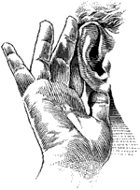
Hearing vs. Listening
“Was I paying attention?”

Slide 39
Hearing vs. Listening
Do you think there is a difference between hearing and listening?
You are right, there is!
Hearing is simply the act of perceiving sound by the ear. If you are not hearing-impaired, hearing simply happens.
Listening, however, is something you consciously choose to do. Listening requires concentration so that your brain processes meaning from words and sentences. Listening leads to learning.

Slide 40
Most people tend to be "hard of listening" rather than "hard of hearing."

Slide 41
Difference between hearing and LISTENING
LISTENING
Listening means to interpret the noise, understanding it and provide an adequate response to it.
Listening is a conscious choice that demands your attention and concentration.
Listening is a skill that can be learned.
HEARING
Hearing is only refers to your ears picking up noise.
Hearing is a passive occurrence that requires no effort.
Hearing is a physical ability.

Slide 42
Hearing is considered to be a biological phenomenon.
In hearing, after the brain receives the nerve impulses it may or may not sends feedback.
Listening is biological as well as psychological process.
In listening , after the brain receives the nerve impulses and deciphers it ,it then sends feedback.

Slide 43
The process of hearing is unintentional and ongoing.
Hearing is an auditory perception of sounds.
Hearing is the process of just absorbing the message without any involvement.
The process of listening is intentional ,systematic and specific.
Listening is the interpretation of the sounds that are heard.
Listening is the process of converting an idea or thought into message with complete involvement.

Slide 44
Hearing is a one way process where the listener plays no role.
Listening is a two way process where the listener plays an important role.

Slide 45
The Process of Listening

Slide 46
The Process.....
Selecting – Choosing Stimuli
Hearing – Receiving data
Attending – Focusing Attention
Responding - Feedback
Understanding – Assigning Meaning
Evaluating – Analyzing and Judging

Slide 47
Active Listening
… Allows you to make sure you hear the words and understand the meaning behind the words
Goal: go beyond listening to understanding

Slide 48
Active Listening Requires…
Definite Intent to Listen
Focus on the Speaker
Verbal and Non-Verbal Encouragers
Feedback Loop to Insure Accuracy

Slide 49
Active Listening (4 Steps)
Listen
Question
Reflect-Paraphrase
Agree

Slide 50
Step 1: Listen
To Feelings As Well As Words
Words – Emotions -- Implications
Focus on Speaker
Don’t plan, speak, or get distracted
What Is Speaker Talking About?
Topic? Speaker? Listener? Others?
Look At Speaker
Use Verbal & Non-Verbal Encouragers

Slide 51
Step 2: Question
3 Purposes
Demonstrates you are listening
Gather information
Clarification
Open-ended
Tell me more?
How did you feel?
Then what happened?

Slide 52
Step 3: Reflect-Paraphrase
Reflect What Is Said (In your words)
Reflect Feelings
Reframe
Capture the essence of the communication
Remove negative framing
Move toward problem solving

Slide 53
Step 4: Agree
Get Speaker’s Consent to Your Reframing
Speaker Has Been Heard and Knows It!
Solution Is Near!

Slide 54
Active Listening -the listener participates fully in the communication process -view communication as a dynamic, transactional process of sending and receiving messages
Active listeners:
Listen attentively
Provide feedback
Strive to understand and remember messages
Rewards:
Better grades in school
Enjoy conversations
Make fewer mistakes
Perform better
More productive

Slide 55
Passive Listening -the listener does not actively participate in interaction
Passive listeners:
Easily become bored or distracted
Ask few questions
Give negative nonverbal feedback
Rewards:
Generally none
Results:
Boredom, apathy, and lack of interest
“lazy” listening
View communication as a one-way process rather than as a give-and-take

Slide 56
Basis of Distinction | Active Listening | Passive Listening
Definition | Active listening means mindful and actively hearing and attempting to comprehend the meaning of the speakers. | Passive listening means showing like listening to the speaker but not making an attempt to comprehend the meanings.
Connectivity Level | Listener connects with the world and actively participates with the goal of problem-solving | Listener disconnects himself from the outsiders and has minimal interaction with others
Self-Responsibility | Take responsibility for their own learning and growth | Avoids responsibility for learning and problem-solving
Mental Approach | Sharp mind, alert to explore, reflect on the information | Accepts and retain information as-is with no intention to question or challenge the idea for improvement
Self-Motivation Level | Strong | Weak
Engagement Level | High | Low
Will-Power | Strong-willed, interested in new ideas, open-minded | Narrow-minded, low or no will power, unreceptive to new ideas

Slide 57
Active Versus Passive listening
Show keenness
Expressions
Alertness
Questions- ask
Not neglecting physical aspects
Valid reason for criticism

Slide 58
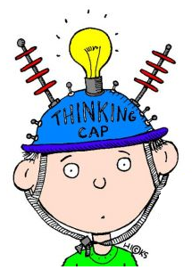




Types Of Listening
Informative Listening
Appreciative Listening
Comprehensive
Listening
Empathetic Listening
Critical Listening

Slide 59
Types of Listening
Appreciative Listening- this for deriving aesthetic pleasure, Listening for fun—to laugh, cry, use your imagination, or extend your creativity as we do when we listen to a comedian,musician or entertainer.
Empathetic Listening- we provide emotional and moral support in the form of it. You try to put yourself in another person’s place or see the world through his or her eyes e.g psychiatrists listening to their patients.
Comprehensive –listening to comprehend ideas and information in order to achieve a specific purpose or goal e.g listen to lecture and Listening to announcements
.

Slide 60
Critical Listening: Listening to understand, analyze, and evaluate messages so you can accept or reject a point of view, make a decision, or take action
when the purpose is to accept or reject the message or evaluate it critically. e.g listening to sales person before making purchase or listening to politicians .

Slide 61
Effective Listening
Effective listening requires an understanding that it is not just the speaker's responsibility to make sure he/she is understood.
The listener has a major role to play in hearing the complete message.
The following ideas will assist the listener in understanding the message.

Slide 62

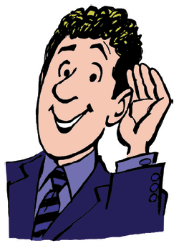
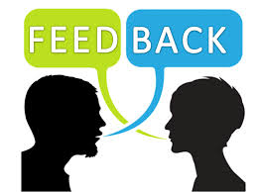


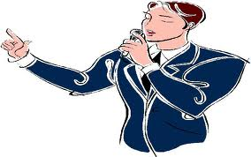

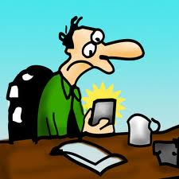

Kinds of Listeners
ACTIVE LISTENER
PASSIVE LISTENER
IMPATIENT LISTENER

Slide 63
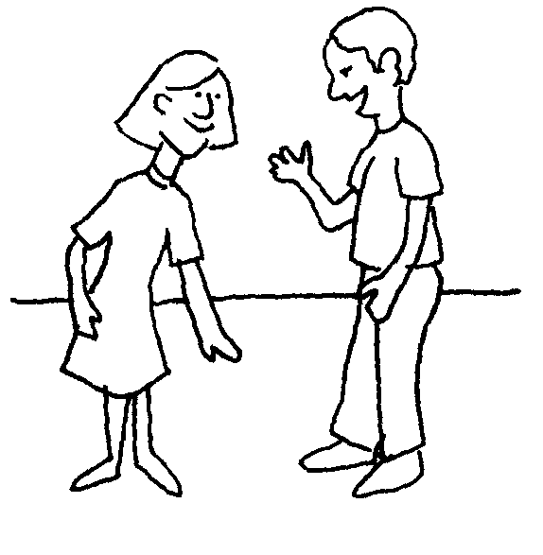
BARRIERS TO LISTENING
Effective listening is arguably one of the most important skills to have nowadays. Personal relationships need effective listening skills to face complicated issues together. Business people and employees need effective listening skills to solve complex problems quickly and stay competitive. Students and professors need it to understand complex issues in their fields. Thus, it is beneficial if we can understand and eliminate listening barriers that blocks deep, harmonious and lasting relationships.

Slide 64
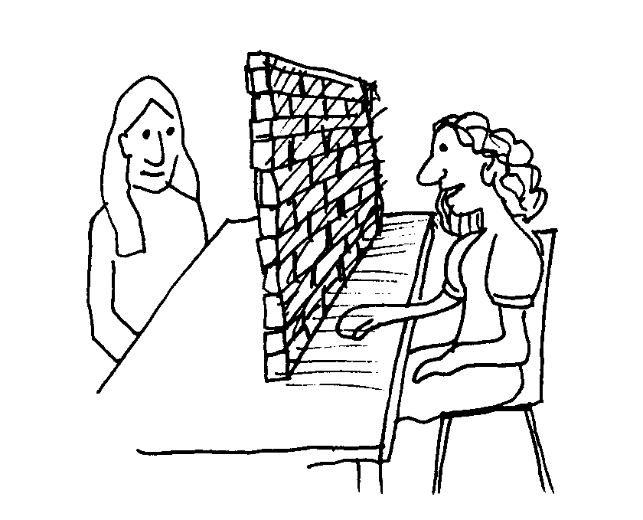
BARRIERS TO LISTENING
Barriers to listening take many forms. It is inevitable that barriers will exist in any interaction, but anything which stops concentration, allowing the mind to wander off the topic, must be recognized and overcome if fully successful communication is to take place.

Slide 65



Common Barriers to Listening
Distraction in your mind
Wandering attention
Planning a reply
Lack of interest

Slide 66
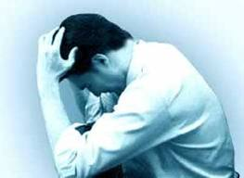


Common Barriers to Listening
Being self centered
Avoiding what is difficult
Excessive note-taking
Emotional blocks

Slide 67

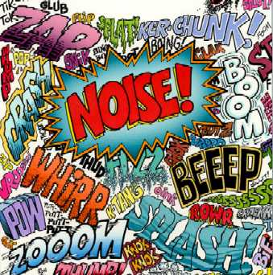
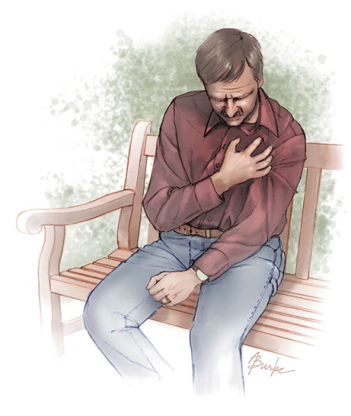
Common Barriers to Listening
Looking for every opportunity to interrupt
Impatience
External noise and disturbance
Poor health

Slide 68
How to Improve Your Passive Listening Skills
The key to becoming a better communicator lies within your ability to listen. Most people spend more time speaking or crafting a response in their head instead of actually paying attention to what the speaker is saying. I heard a quote recently that said something to the effect of, “we listen to respond, not to understand.” Becoming a better passive listener is an important skill, and can be attained with the following simple steps:
1. Focus
Turn off your electronics (yes, even your phone!) and try to concentrate on the speaker. Put your laptop away, and don’t respond to any distractions. Phone calls, emails, and text messages can wait.
2. Position
Face the speaker and sit in a position that tells him you’re ready to listen. Keep your legs uncrossed and your arms open. Limit body movement, and lean in toward the speaker so she knows you’re paying attention. There’s almost nothing worse than taking the time to talk to someone who isn’t displaying open body language, it’s the first clue that you have a fake listener on your hands

Slide 69
3. Silence
Passive listening requires little to zero verbal replies from the listener. As a listener, try to focus
on the speaker’s body language as well as his words. You may reply silently with a nod, or the
response, “tell me more . . .” however, passive listening primarily asks the listener to remain
completely quiet.
4. Enhanced Focus
This goes along with the first step, once you’ve removed distractions like cell phones and
personal computers further enhance your ability to practice effective passive listening by
refraining from indulging in a personal internal dialog. Try to avoid crafting any kind of response
to what the speaker says instead focus exclusively on his or her words and body language. Does
the speaker have an open body position? Is his or her arms crossed? Do his or her words connect somehow to what he or she is saying? Without crafting a response, simply sit passively and absorb your speaker’s words, body language, and facial expressions. You’ll be amazed at how much information you can glean from these simple bodily clues.

Slide 70
5. Lean In
Again, part of a successful passive listener’s body vocabulary, leaning in tells the listener that
you are truly engaged with the subject, even if you aren’t responding verbally. Leaning in is an
essential tool of the passive listener, and enables the speaker to relax and express him or herself
more openly.

Slide 71
The 10 Principles of Listening
A good listener will listen not only to what is being said, but also to what is left unsaid or only
partially said.
Effective listening involves observing body language and noticing inconsistencies between
verbal and non-verbal messages.
For example, if someone tells you that they are happy with their life but through gritted teeth or
with tears filling their eyes, you should consider that the verbal and non-verbal messages are in
conflict, they may not mean what they say
1. Stop Talking
“If we were supposed to talk more than we listen, we would have two tongues and one ear.”
-Mark Twain.
Don't talk, listen. When somebody else is talking listen to what they are saying, do not interrupt,
talk over them or finish their sentences for them. Stop, just listen. When the other person has
finished talking you may need to clarify to ensure you have received their message accurately

Slide 72
2. Prepare Yourself to Listen
Relax. Focus on the speaker. Put other things out of mind. The human mind is easily distracted
by other thoughts – what’s for lunch, what time do I need to leave to catch my train, is it going to
rain – try to put other thoughts out of mind and concentrate on the messages that are being
Communicated
3. Put the Speaker at Ease
Help the speaker to feel free to speak. Remember their needs and concerns. Nod or use other
gestures or words to encourage them to continue. Maintain eye contact but don’t stare – show
you are listening and understanding what is being said.
4. Remove Distractions
Focus on what is being said: don’t doodle, shuffle papers, look out the window, and pick your
fingernails or similar. Avoid unnecessary interruptions. These behaviours disrupt the listening
process and send messages to the speaker that you are bored or distracted.
5. Empathise
Try to understand the other person’s point of view. Look at issues from their perspective. Let go
of preconceived ideas. By having an open mind we can more fully empathise with the speaker.
If the speaker says something that you disagree with then wait and construct an argument to
counter what is said but keep an open mind to the views and opinions of others.

Slide 73
6. Be Patient
A pause, even a long pause, does not necessarily mean that the speaker has finished. Be patient and let the speaker continue in their own time, sometimes it takes time to formulate what to say and how to say it. Never interrupt or finish a sentence for someone.
7. Avoid Personal Prejudice
Try to be impartial. Don't become irritated and don't let the person’s habits or mannerisms distract you from what they are really saying. Everybody has a different way of speaking – some people are for example more nervous or shy than others, some have regional accents or make excessive arm movements, some people like to pace whilst talking - others like to sit still. Focus on what is being said and try to ignore styles of delivery.
8. Listen to the Tone
Volume and tone both add to what someone is saying. A good speaker will use both volume and tone to their advantage to keep an audience attentive; everybody will use pitch, tone and volume of voice in certain situations – let these help you to understand the emphasis of what is being said

Slide 74
9. Listen for Ideas – Not Just Words
You need to get the whole picture, not just isolated bits and pieces. Maybe one of the most
difficult aspects of listening is the ability to link together pieces of information to reveal the ideas
of others. With proper concentration, letting go of distractions, and focus this becomes easier.
10. Wait and Watch for Non-Verbal Communication
Gestures, facial expressions, and eye-movements can all be important. We don’t just listen with
our ears but also with our eyes – watch and pick up the additional information being transmitted
via non-verbal communication.
Do not jump to conclusions about what you see and hear. You should always seek clarification to
ensure that your understanding is correct.

Slide 75
SPEAKING SKILLS
Speaking skill: is the art of communications and one of 4 productive skill, that must mastered in learning foreign language. Good speaking skills is the act of generating words that can be understood by listeners. A good speaker is clear and informative.

Slide 76
Tips to improve the speaking skill
Find native English speakers. Talking to actual native speakers is the most effective way to improve your English skills, speaking or otherwise.
Listen to the music of English: No, not English music, the music of English -- its lilt, its prosody, the sing-songyness of it. The intonation. Even if you speak perfect English technically, if you speak it like a robot you're not speaking it the way it's meant to be spoken.
Slow down. Above all, if you want to be understood, slow down. The more clearly you speak, the better chance your listener has of understanding you. It's tempting to get nervous and want to speed up to get it all over with, but you can't do that! Clarity is key -- for some native English speakers, too!

Slide 77
Record yourself: Though we hear ourselves all the time, we really don't know quite what we sound like. So record yourself! What are the weak and strong points you hear in your speech? And then you can concentrate on what you need to work on.A great idea is to get a book on tape, record yourself reading an excerpt from it (or mimicking the narrator), and comparing yourself to the recording. That way you can do it over and over until you get it right!
Speak English at home : This is the biggest, easiest mistake to make. You go about your day, you're on the job working partly in English, you go to your English class, and then you go home and revert back to your native tongue.

Slide 78
Strategies for Developing Speaking Skills
1. Using minimal responses Language learners who lack confidence in their ability to participate successfully in oral interaction often listen in silence while others do the talking. One way to encourage such learners to begin to participate is to help them build up a stock of minimal responses that they can use in different types of exchanges. Such responses can be especially useful for beginners.
2. Recognizing scripts Some communication situations are associated with a predictable set of spoken exchanges -- a script. Greetings, apologies, compliments, invitations, and other functions that are influenced by social and cultural norms often follow patterns or scripts. So do the transactional exchanges involved in activities such as obtaining information and making a purchase.

Slide 79
3. Using language to talk about language learners are often too embarrassed or shy to say anything when they do not understand another speaker or when they realize that a conversation partner has not understood them. Instructors can help students overcome this reticence by assuring them that misunderstanding and the need for clarification can occur in any type of interaction, whatever the participants' language skill levels.

Slide 80
Reading Comprehension Skills
We have learnt that there are four skills that come under Dimensions of Communication. The 4 language Skills are:
1. Listening [Receptive Skill]
2. Reading [ Receptive Skill]
3. Speaking[Productive skill]
4. Writing [Productive skill]

Slide 81
When do we use reading
To learn the script of a language •
To learn concepts of any topic in details •
To get entertained •
To get directions •
To understand instructions
In fact, Reading is the source of most of our information.

Slide 82
How is reading different from listening?
As a receptive skill, reading is more effective than listening.
• In listening, we need to pay higher attention and tax our memory more. This is because the facts are spoken; they are gone once spoken.
• In reading, however, we can get back to the text again if we miss a point. The facts are written down, and help us memorize them.

Slide 83
4 styles of reading a text
Depending on our purpose of reading, we adopt any of the four styles generally:
Skimming
• Scanning
• Churning
• Assimilating

Slide 84
Activity
Can you take a look at the pictures and tell:
1. Which one is related to law and order?
2. Which one gives caution to public?

Slide 85
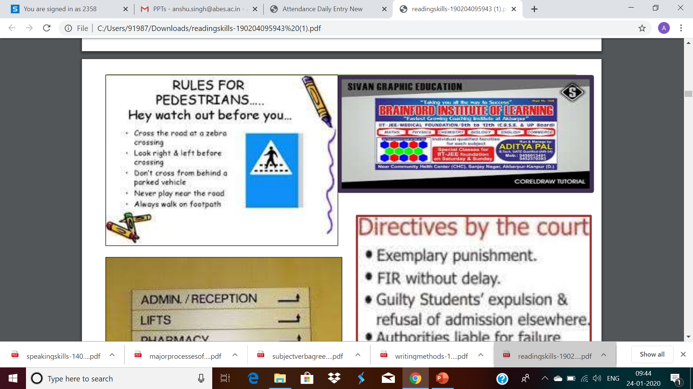

Slide 86
How to skim?
Every passage is built around keywords. Those keywords tell us what the passage is about.

Slide 87
Exercise: Skim the passage and tell: 1. Topic of the paragraph 2. Purpose of the author
Movies are an essential part of our lives. Surely, they entertain us most of the time. But besides that, they also inform us—of people, events, culture an tradition.

Slide 88
Answer:
Topic = Movies
Purpose = Argue in favor of movies

Slide 89
Exercise: Skim the passage and tell: 1. Topic of the paragraph 2. Purpose of the author
A break in Goa can be much more than just a holiday on beautiful beaches. The Indian state has a fast-developing food and drink scene, that embraces local and international flavours. The stylish modern hotels provide a luxury holiday experience in food and accommodation.

Slide 90
Answers
Topic: Goa as a holiday destination.
Purpose: Persuade readers to visit Goa

Slide 91
Style 1 : Skimming
Fast browsing of the entire passage.
We get a rough idea about the topic of the passage
Humans have an inborn habit of trying to do things efficiently. They need to save time.
When we are searching for an information, and we have a large number of texts to choose from, we do a fast-browsing to decide which texts to read, and which to reject.

Slide 92
Targets of skimming
To understand:
what the topic is about
Who is the target audience
Which type of text it is, i.e. Report, advertisement, article, etc
What is the purpose of the text? To inform? To explain? Or to persuade?
The above questions give us a frame of mind to judge the text.

Slide 93
Style 2 : Scanning
In this, we look for more specific information in a text.
• While doing a reading comprehension, we take a look at the questions asked on the passage.
• When we re-read the text to locate those specific information, it is called scanning.

Slide 94
Activity:
You will read description about a Projector
Scan the Text and find:
What are the connectivity details of this product?

Slide 95
EGATE i9 LED HD Projector (Black) HD 1920 x 1080 - 120-inch Display
INDIAN BRAND – INDIA SERVICE CENTRE – TOLL FREE NO. 1800 123 6847
• 1 year warranty provided by the manufacturer from date of purchase
• 30000 hrs life long LED lamp • HD 1920 X 1080 Support & 800 X 480 Native Resolution
• 1000 : 1 High Contrast Ratio; 120” Large screen display
• 1500 Lumen* / 120 Ansi; Direct Play From USB
• Multiple Interface – HDMI/ VGA / USB / AV / Sd Card / Audio Out
• Home theatre projection from set-top box , DVD, Blue ray & pen drive

Slide 96
Style 3 : Churning
Churning means interpretation and inference.
Churning
Interpretation: Getting the summary of all the important points on a topic.
Inference: Reading between the lines. Understanding facts that are not stated openly.

Slide 97
Interpretation: How is it done?
Depending on the question, we need to decide what angle we are going to take, to interpret a text.
Generally, a text contains discussion on more than one keyword. You have to collect information on the specific keyword that is asked in the question.

Slide 98
Let us do a quick activity: Read the paragraph next slide

Slide 99
The Vikings were people who lived in northern Europe and the Scandinavian countries. They were fierce warriors and excellent sea-farers. Their ship could travel fast in rough seas. They were a hardy race, who lived in harsh climatic conditions. In 793 AD, the Vikings crossed the dangerous North Sea, and invaded England. Their plan was to loot. However, the warm weather and the rich soil changed their hearts, and they decided to settle. So, they defeated the Anglo-Saxon kings, and captured their lands. By 800 AD, most of England was under the Vikings.

Slide 100
Now recall the passage on the basis of the two keywords:
• The Vikings
• England

Slide 101
Answers
Vikings
They lived in Scandinavia and Northern Europe.
• They were warriors and sea-farers.
• They built ship to cross the North Sea to reach England in 793 AD.
• They found Britain to be a comfortable place than their homelands.
• And so they settled down.
• They conquered most of England by 800 AD.

Slide 102
Answers
England
It lies across the North Sea from Northern Europe.
• Its climate is favorable than Scandinavian countries.
• Its soil is also rich and fertile.
• The Vikings invaded it in 793 AD.
• It was then ruled by Anglo-Saxons.

Slide 103
Inference: How is it drawn?
In order to draw inference,
one has to apply one’s log
and try to connect the dots.
Take the last paragraph for example.
Ques. The Vikings came to loot. Why did they decide to settle in England?

Slide 104
How to draw inference?
Ans.
Because climate = warm.
Soil = Fertile. Therefore Farming is possible.
Farming is safer than hunting, or crossing seas.

Slide 105
How to draw inference?
Ans. Because climate = warm.
Soil = Fertile. Therefore Farming is possible.
Farming is safer than hunting, or crossing seas.
This Answer is not stated openly in the text. You have to guess it. This is inference.

Slide 106
Techniques to do Churning
Churning Techniques = Understanding 2 things:
Word Meaning
Coherence

Slide 107
Techniques to do Churning
Churning Techniques = Understanding 2 things:
Word Meaning
✓Same word, Different meaning in 2 contexts ✓Unknown word, meaning guessed via context ✓Unknown word, guessed via root words ✓Reading sense-groups ✓Knowing the topic beforehand.
Coherence

Slide 108
Techniques to do Churning
Churning Techniques = Understanding 2 things:
Word Meaning
Coherence
Discourse Markers

Slide 109
Word Meanings
Understanding different meaning based on contexts.
Guess the unknown words from context.
Guess meaning from root words.
Read not the sentence, but sense-groups.
Try to get an overview beforehand.

Slide 110
Understanding different meanings based on context
A single word can have two meanings in two different contexts. This is called Polysemy.
Eg.: HR Manager to Candidate: “We appreciate your interest in our company.”
The Rupee appreciated against the Dollar yesterday.

Slide 111
Understanding different meanings based on context
A single word can have two meanings in two different contexts. This is called Polysemy.
[Appreciate = Praise]
Eg.: HR Manager to Candidate: “We appreciate your interest in our company.”
The Rupee appreciated against the Dollar yesterday
[Appreciate = Improve in value]

Slide 112
b. Unknown word = meaning guessed via context
If a word is important, it will have clues about its meaning in the surrounding sentences.
Eg.: Procrastination is an evil. It prevents us from taking fast decisions. Often we bother so much about the results of a decision, that we fail to take a decision altogether.

Slide 113
b. Unknown word = meaning guessed via context
If a word is important, it will have clues about its meaning in the surrounding sentences.
Eg.: Procrastination is an evil. It prevents us from taking fast decisions. Often we bother so much about the results of a decision, that we fail to take a decision altogether.
[Therefore, meaning of ‘procrastination’= undecided mind].

Slide 114
c. Guess meaning from root words
• Words are built around roots.
• Often, we know the meaning of certain roots.
• When we see those roots, we can guess the meaning of that word.
Eg: Anything that ends with –less, will mean ‘lacking in’. Anything that starts with ‘hyper’, means ‘beyond normal’. Eg. : Politicians often talk in hyperboles. They always claim 90 % development during their party’s rule.

Slide 115
d. Read not the sentence, but sense-groups
Some paragraphs contain heavy words in a sentence
Don’t read word-by word then.
Instead, divide the sentence into sense groups.

Slide 116
Example
“This method has now been augmented by the techniques of molecular biology, which allow introduction into plants entirely new characteristics, including genes, originally found in other plants.”

Slide 117
Example
“This method has now been augmented by the techniques of molecular biology, which allow introduction into plants entirely new characteristics, including genes, originally found in other plants.”

Slide 118
e. Try to get an overview of the topic beforehand
• Any technical document is likely to contain technical terms that are specific to that subject.
• If you are familiar with the subject, reading becomes easier.
For example, if you are familiar with biology, you will read a passage on genes and transplants faster than a layman.

Slide 119
Discourse Markers
• Discourse markers are words that come at the beginning of sentences, like ‘clearly’, ‘therefore’, ‘lastly’, ‘on the other hand’, ‘however’, etc.
They indicate whether the sentence is an example, a conclusion, or an opposite opinion.
They help us understand how an idea is developed in a passage.

Slide 120
Reading Style 4 : Assimilating
When we attempt to make a mental map of the entire passage that we have read, it is called assimilating.
When we say we have understood a concept after reading a chapter, we have actually done assimilation.

Slide 121
Steps to do Assimilation:
Churning has made available the information. Convert the information into an idea. Think about it at a personal level.
Look for pictures, videos and other texts related to the topic to get better knowledge.
• Discuss with peers to get their view-points as well. • This will help you plant a mental-map of the information you have read.

Slide 122
Aspects of Assimilation:
What you can do after assimilating a text?
Summarize the main points
✓ Recall the structure of the passage: What was in Introduction; supporting sentences; conclusion.
✓ Discuss about the author’s viewpoint: Why did he write this passage? What was his attitude towards the topic— positive or negative?
✓ Retain the information in memory.
✓ Deliver that memorized information to another person.

Slide 123
SQ4R Reading Technique for Optimum Effectiveness-
SURVEY: Flip through the chapter quickly to get a sense of what is covered. Look at headings and keys terms, and read the final paragraph.
QUESTION: Turn headings into questions to guide your reading. You can keep track of your questions by using the Cornell Method of note-taking.
READ: Read the chapter, looking for the answer to the questions you posed.
REFLECT: Think about what you have read, and relate it to other information you have learned.
RECITE: Without looking at the text, restate your question and formulate an answer in your own words.
REVIEW: At the end of the chapter look over your notes and familiarize yourself with key points.

Slide 124
Writing Methods
Can you guess the next lines to these sentences?
• College life is the best time of our lives. --------------------------------------------------------------------------------------
• Chat over Whatsapp is easier than talking in front ------------------------------------------------------------------------------------------------------------------

Slide 125
Can you guess the starting lines?
_______________________________ _______________________________ _______________________________ That’s why, you should watch Mirzapur.

Slide 126
Can you guess the starting and ending lines?
________________________________ ________________________________ However, movies can have negative effects as well, side by side its positives. _________________________________ _________________________________

Slide 127
Can you trace the most important line?
Different people spend their holidays in different ways. Some like to travel to nice places. Some prefer staying home and watching movies. Still, there are some who make a get-together with their relatives.

Slide 128
Can you trace the most important line?
Different people spend their holidays in different ways. Some like to travel to nice places. Some prefer staying home and watching movies. Still, there are some who make a get-together with their relatives.

Slide 129
Can you trace the most important line?
Distance education lets you to have a degree while you are doing a job. It is also good for poor students who do not have good colleges nearby, and cannot afford to go to another city to study. Clearly, distance learning is a strong alternative to college education.

Slide 130
Can you trace the most important line?
Distance education lets you to have a degree while you are doing a job. It is also good for poor students who do not have good colleges nearby, and cannot afford to go to another city to study. Clearly, distance learning is a strong alternative to college education.

Slide 131
So, what you have learnt so far
A paragraph is a collection of sentences.
• The sentences are connected to each other.
• There is a complete idea, a ‘topic’ developed in a paragraph.
• One line in the paragraph is the most important line in it.
• This line could be at the beginning, end, or middle.

Slide 132
Definition: What is a Paragraph?
A paragraph is a collection of sentences, that logically present one single idea.
One sentence among them is the most important one. It is called the Topic sentence.
The other sentences give support to the Topic sentence. These sentences are called supporting sentences.

Slide 133
Methods of Paragraph Writing
Depending upon our purpose, we can order the Topic sentence and the Supporting sentences in 7 specific ways. They are:
Deductive, Inductive, Exposition, Chronological, Spatial, Linear, & Interrupted.
These are called ‘Methods of Paragraph Writing’.

Slide 134
Purpose: Defending an idea
When our purpose is to defend an idea by providing evidence, we write the paragraph in Deductive method.
The topic sentence comes at the beginning. It states a fact.
The supporting sentences come after it, and give evidence that the fact is true.

Slide 135
Deductive paragraph: Example
Mental depression is a dangerous symptom. First, it can affect any one, be he an adult or a child. This is because of cut-throat competition in every area of life. Second, depression has no physical indications. This makes it hard to detect. Third, people have the false idea that depression means madness. Clearly, depression is a deadly disease, and is hard to treat.

Slide 136
Purpose: To make an inference
When we put together clues to reach a conclusion, we make an inference.
While we make an inference, we use Inductive method of Paragraph writing
The Topic sentence comes at the last, as a conclusion.
The supporting sentences come at the beginning, as clues that lead to the conclusion.

Slide 137
Inductive Paragraph: Example
Aryan reached late in office today. He comes to office by public transport. He always starts early from his home to avoid traffic. Therefore, the bus he took today must have had a breakdown.

Slide 138
Purpose: Explaining a concept
When we have to explain a concept to a person, we make a lot of effort to do so through examples, through comparing and contrasting with other concepts, and through clear-cut description of how it looks/feels.
Such explaining is called the Expository method.
Any Wikipedia article is Expository in nature.

Slide 139
Expository Method: Example
Mirzapur is a crime-based TV series released in 2018, on Amazon Prime. It revolves around drugs, guns and lawlessness. It depicts the rule of mafia dons and gang-rivalry in the Purvanchal region of Uttar Pradesh. Its season 1 consists of 9 episodes in total. In comparison with Sacred Games, it has scored more popularity among the viewers.

Slide 140
Purpose: Giving background information
Sometimes, we have to give a background information of a person or event. For example, medical history; tracing the development of a country, a thing, an action down the ages.
Then we use Chronological method.
The topic sentence is written in the beginning
The supporting sentences give a history, with the oldest dates first.

Slide 141
Chronological Method: Example
Going to halls for watching movies has become redundant nowadays. In the 90’s, people went to movie halls to watch movies only. Those were the times of television and VCRs. By the 2000s, people started having their personal computers. So movies were watched in DVDs. Now, with the advent of android phone and 4G connectivity, people can watch movies right in their mobiles.

Slide 142
Purpose: Describing objects in a place
When we have to give exact description of a place, so that people have clear idea of where things are kept, we use Spatial method of paragraph writing.
The Topic sentence comes at the beginning, telling the name of the place.
The supporting sentences give details of things positioned in that place.

Slide 143
Spatial Method: Example
ABES is located on NH 24. On entering the gate, you will find a road that leads to two opposite sides. Follow the left-hand side, and you will come across Aryabhatt-block, Pharmacy-block, and the finally, the Boys’ hostel. Follow the right-hand side road, you will come across the bhabha block, and the Girls’ hostel.

Slide 144
Purpose: Step-by-Step description of a Process
Often, we have to write description of a process in manuals.
We have to write every step, from starting point to the finish.
Then, we use Linear method.
In linear method, one line logically leads to the other.

Slide 145
Linear method: Example
Uninstalling a program needs a few, simple steps. First, go to the Start Menu. Then, Go to Control Panel. Next, click Uninstall a Program. Then, select the program you want to remove. Finally, click Uninstall at the top of the page.

Slide 146
Purpose: Narrating an experience in a dramatic way
In chronological method, we found events narrated like a diary-entry
But often, in order to sound more dramatic and interesting, we break the strict chronology. We talk about present, and then go back to past, and then start talking about future.
This is called Interrupted method. They show the interrupted way of our thoughts.

Slide 147
Interrupted Method: Example
I am a fan of movies of superheroes. From Baahubali to Spiderman, I love them all. When I was a child, I had a huge obsession for Shaktiman. I even tried jumping off a terrace, but was luckily saved. Now, I just use jackets and T Shirts to show my obsession. Someday, I dream of creating a superhero series on TV myself.

Slide 148
Methods of Paragraph Writing
Methods
Deductive: for facts
Inductive: for inference
Exposition : For information
Chronological : for development down the Ages
Spatial : For directions & locations
Linear : for process
Interrupted : for dramatic narration

Slide 149
Features of technical writing
Accuracy
Brevity
Clarity
Objectivity
Impersonal Language

Slide 150
Accuracy
Accuracy demands exactness and precision.
2 types
Accuracy of Information
accuracy of expression
Means grammatical, punctuation,spelling,accent,intonation correctness, non –verbal mannerisms.
Now look at the following sentences. Say which sentence is correct and why.
a) Only Muneer scored two goals.
b) Two goals were scored by Muneer only.
c) Muneer scored two goals only.
d) Two goals only were scored by Muneer.

Slide 151
Characteristics of Precision
Precision is the quality of being exact , accurate , and definite.
In technical communication , precision refers to the art of attaining exact correspondence between the matter to be communicated and its presentation.
Techniques of Precision
Simple and familiar words.
Exact word and phrases.
Using simple and Familiar words.

Slide 152
Simple and familiar words.
Ignite –burn
Retained unenclosed-open
Yielding - producing
Colloquial- informal
Tumultuous- noisy
Exuberant -lively

Slide 153
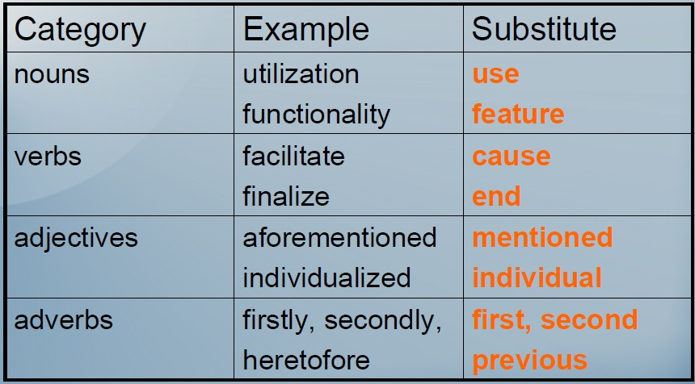
Word Choice:

Slide 154
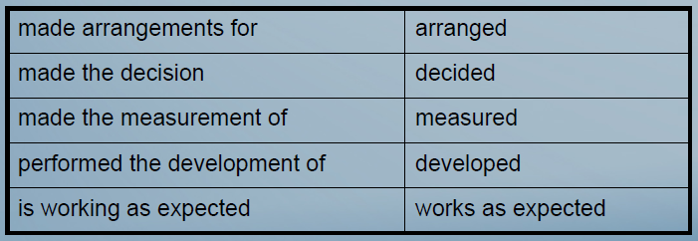
Word Choice
Avoid too many “to be” verbs
for example: “is” “was” “were” “has been” “have been”.
Avoid excess words, which slow comprehension of the main point.

Slide 155
II-Using exact words And Phrases
Stationary-
Stationery-
Complement
compliment

Slide 156
III-Avoid difficult words and complex Jargon
Jargon: a vocabulary particular to a place of work (abbreviations, slang)
• Audience familiarity with the topic determines appropriate use of jargon
Ex. 1: For the first year, the links with SDPC and the HAC were not connected, and all required OCS input data were artificially loaded. Thus CATCH22 and MERWIN were not available.
Because some of the links in the computer system were not connected the first year, we could not run all the software codes.

Slide 157
Brevity
Brevity means economy in word usage, pruning away useless words. We should avoid repetition and redundancy.
Never use two words when one word will do.
Look at the following sentences.
1) Maria lives in a city called Bangalore, in a place called Indira Nagar.
2) Maria lives in Indira Nagar in Bangalore.
3) On the face of it: apparently

Slide 158
Techniques of Brevity
Avoid Wordiness
Avoid repetition

Slide 159
Avoid wordiness
✖ It may be expected that the prevalence of relatively mild asthma could be underestimated.
✓ The prevalence of mild asthma could have been underestimated.
✖ The severity of this disease has been demonstrated to be associated with age.
✓ The severity of this disease increases with age.
Definitive evidence: has been shown to be→ is
Less certain evidence: has been shown to be→ may be/can

Slide 160
Avoid repetition
• Repeating key terms throughout a paragraph can also help to maintain thought processes but avoid using the same word twice in one sentence because it becomes clumsy and boring.
• 1 ✖ We need reliable screening procedures for identifying the signs and symptoms to identify children who are at greatest risk.
•✓ We need reliable screening tools to identify children who are at greatest risk.
• 2 ✖ No adequate clinical measures for quantifying back abnormalities in the clinical setting are currently available.
•✓ There are no adequate methods for quantifying back abnormalities in clinical settings.

Slide 161
Clarity
Clarity in writing means the ability to state our thoughts without any ambiguity.
It is unnecessary to use a polysyllabic word where a monosyllabic one will do. Needless use of long words or abstract words result in obscurity
There can be two types of clarity.
grammatical and conceptual.

Slide 162
Avoid Ambiguity
Choose words whose meanings are clear .
Order the words in your sentences carefully.
Ex. 1: In low water temperatures and high toxicity levels of oil, we tested how well the microorganisms survived.
Ex. 2: We tested how well the
microorganisms survived in low water temperatures and high toxicity levels of oil.

Slide 163
Ex. 1: In low water temperatures and high toxicity levels of oil, we tested how well the microorganisms survived.
Ex. 2: We tested how well the
microorganisms survived in low water temperatures and high toxicity levels of oil.

Slide 164
Clarity: Define the Unfamiliar
If you must abbreviate, define the term in its first occurrence, and put abbreviations in parentheses.
Italicize first occurrence of unfamiliar terms and define them right away.

Slide 165
Grammatical Clarity
One of the aid to clarity is adequate punctuation.
Look at the following sentence:
I wrote a book with Mr.Khalil and Mr. Mabruk and Mr. Nayim edited it
The ambiguity in the above sentence can be removed only by a comma.
2) I wrote a book with Mr.Khalil, and Mr. Mabruk and Mr. Nayim edited it.
3) I wrote a book with Mr.Khalil and Mr. Mabruk ,and Mr. Nayim edited it.

Slide 166
Pronoun reference
He took out his handkerchief and his pen, then wiped his forehead, blew his nose, and put it back into his pocket.
Did he put his nose back in to his pocket(!) or his pen or his handkerchief?
For clarity, each pronoun should not be far away from the noun it refers to.

Slide 167
Conceptual Clarity
By conceptual clarity, we mean that whatever concepts we are trying to describe should be such that the reader should be able to easily empathize with what we write.
Muna is a teacher at the college level and she is a knowledgeable person. She is thin but her students say that she can keep her class under control.
To show that I liked her I wrote:
Muna is a professor and she is a real scholar. She is slim and her students say that she is a born leader.
To show that I disliked her I wrote:
Muna behaves like a school ma’am and is a real egghead. She is skinny and her students say that he is a Hitler, a dictator to the core.

Slide 168
Techniques of Clarity
Use direct language
No scope for
Roundabout construction
Indirect expressions
Exaggeration
Artificial eloquence

Slide 169
Avoid roundabout constructions
✖ There are three distinct flow characteristics in these photographs.
✓ These photographs show three distinct flow characteristics.
✖ It might be expected that there would be some flow separation. ✓ Some flow separation might be expected.
✖ It appears that the flow field over the nozzles is complex.
✓ The flow field over the nozzles appears to be complex. ✖ It was shown in reference 1 that... ✓ Reference 1 showed that...
✓ Hathwell (ref. 1) showed that...
=> Don't postpone important information.

Slide 170
Denotation and Connotation
The denotative meaning of a word is its literal meaning.
Connotation is the underlying feeling that you get , besides the primary meaning of the word.
“Smell” is purely denotative.
“Aroma” gives you a positive feeling and has favourable connotations.
“Stench” makes you wrinkle up your nose and gives you unfavourable connotations.

Slide 171
Objectivity
As technical communication is a systematic discussion , analysis , and interpenetration of facts rather than expression of sentiments and emotions , the speaker or writer is not concerned with subjective comments and personal feelings.
The concentration is on an objective and impersonal presentation of facts.

Slide 173
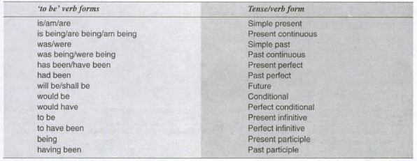

Slide 174
Nuances or Methods of Delivery / Presentation
Good planning is the backbone of good presentation. Equally important or perhaps more important is the manner of delivery.
It is, of course, the power of speech that may turn a dull topic into interesting one whereas poor delivery or bad presentation may spoil the entire presentation howsoever significant it is.
So, once the speaker has planned and developed the content of his presentation, he should begin practicing his delivery, since it is not as important as, what to say, as it’s how to say?

Slide 175
There are a variety of delivery methods but a speaker should choose those which are easier to handle, some such methods are listed below
Memorizing the Manuscript
Reading the Manuscript
Speaking from notes (Extemporaneous)
Impromptu Speaking

Slide 176
Memorizing the Manuscript
(Manuscript – Hand written matter, a copy of a book before it is printed)
This method of presentation can be one of the most effective methods of presentation.
But it requires an extra ordinary power to memorize because if the presenter forgets his text, his speech will sound stilled / unnatural / too formal. Besides he will become a butt of ridicule.
therefore, speaker should avoid memorizing long speeches.
Memorizing a quotation, an opening paragraph, or a few concluding remarks will strengthen his delivery and impress the audience.

Slide 177
Advantage –
It is very easy for speakers to maintain an eye contact with the audience.
The speaker can easily move and make appropriate use of non-verbal communication.
It is possible to finish the speech in allotted time.

Slide 178
Disadvantage
Memorization requires too much time.
There are chances of making it dull and boring because we go exactly by whatever we have memorized.
No flexibility or adaptation is possible.
Memory skills may fail us if not rehearsed properly.
The speaker may get nervous if he forgets a word or a sentence.

Slide 179
Reading the Manuscript
It means read out the written material aloud. This method is often used whenever a complex or technical presentation is made such as the description of some machine or the policy matters of an organization. Reading intelligibly is an art, which can also be learnt after much practice. Once the manuscript of a presentation is prepared, the reader should do a lot of practice and rehearse again and again. In verbatim (word by word) reporting, the reader and listener contact is often interrupted. Moreover, such word for word reporting becomes dull and monotonous. For effective manuscript presentation, the reader should follow the below mentioned suggestions:
Be familiar with the text by reading it again and again
Learn right pronunciation of the technical terms used.
Maintain proper flow of the language for which proper pause and voice modulation can be used

Slide 180
Advantages –
It is a permanent and accurate record of whatever we have to say.
There is no chance of tampering with the facts and figures.
The material is organized systematically.
Language gets polished.

Slide 181
Disadvantages –
As we are reading throughout, we fail to establish eye contact with the audience.
It is rigid and closed as adaptation is difficult.
There is not much scope for non-verbal communication.
Conversational flavor takes a back seat.
In the absence of effective reading skills we fumble over words, punctuations, etc. making it uninteresting.

Slide 182
Speaking from Notes(Extemporaneous)
Making presentation with the help of an outline is a very common method of presentation. The speaker prepares notes on a sheet or cards and then with the help of appropriate audio visual aids, he makes his presentation. This process makes the delivery easy and impressive. The speaker while making presentation maintains eye-contact with the audience and never for a moment the presentation becomes mechanical, dull or monotonous. Practice indeed makes perfect. An inexperienced speaker should do proper rehearsal before making presentation

Slide 183
Advantage
Delivery sounds natural and spontaneous.
As we have enough time to prepare, we work hard on the theme/central idea.
Thorough preparation makes the presenter secure and confident.
Supporting material helps to present the points clearly.
It allows us to establish eye contact and rapport with the audience.
It enables us to move freely, with ease.
It is flexible as adaption is possible if the need arise.

Slide 184
Disadvantage
If preparation is inadequate, we can get lost and feel uncomfortable.
The speech will lose its spontaneity if we start reading from the notes instead of consulting them for reference.

Slide 185
Impromptu Speaking
The word impromptu means done without preparation or planning. The term impromptu speech, thus, means a speech delivered without any preparation done beforehand i.e. unrehearsed delivery in speech. Such impromptu speeches of formal mode should be avoided. They can be made after some caution. To quote Bovee, Thill and Schatzman, “You might have to give an impromptu or unrehearsed speech if you’re called on to speak unexpectedly or if you have agreed to speak but neglected to prepare your speech. Avoid speaking unprepared unless you have spoken countless times on the same topic or are an extremely good public speaker. When you are asked to speak ‘off the cuff’, take a moment to think through what you will say. Then avoid the temptation to ramble.

Slide 186
Advantage –
It sounds very natural.
It allows us to establish eye contact and rapport with the audience.
It is spontaneous.

Slide 187
Disadvantage –
It lacks organized development of ideas.
There is no supplementary material to substantiate the speech.
There is frequent use of vocalized pauses and fillers.
The presentation may turn out to be a failure if the speaker has inadequate proficiency in the language in which he is delivering the presentation.

Slide 188
THINKING STRATEGIES : POSITIVE AND LOGICAL THINKING
Thinking is very important to us as ideas can be generated by thinking. What you think, you become. From morning till evening mind is active. It is very difficult to keep the mind blank; so it is wise to think positive and logical.
POSITIVE THINKING:- Positive thinking is a state of mind in which you see the bright side of life. If you think positive, only good thought will come to your mind and you will flourish in happiness, success and health. You will always look at the goals and overcome the hurdles without any difficulty.

Slide 189
ADVANTAGES OF POSITIVE THINKING:
Positive attitude makes you happier as your brain discharges endorphins which give you the feel of well-being.
You also have optimism in you and your interpretation of the people around you will be good.
If your goals are clear, as you are positive you accomplish them in time.
In adverse situation, positive thinking will enable to think ’That’s good for you as if one door closes another opens up.’
Positive thinkers learn the hard lessons from every setback.
Positive thinkers spread positive thoughts which reflect their attitude to people around them.
It is rightly said, “The pessimist sees difficulty in every opportunity. The optimist sees the opportunity in every difficulty.”

Slide 190
HOW TO BE A POSITIVE THINKER
It is quite simple to train the mind to think positive. You have to focus just on one thought at a time & that is possible as your mind has sufficient bandwidth. You should reflect optimism even if negative events occur. Inspirations and quotes from great thinkers and leaders do magic to indicate positive thoughts. Let us see how you can develop positive thinking:
Live in present
Don’t look for perfection
Talk in positive language
Make contribution the positive way
Have proclivity with positive people
Keep learning continuously
Be thankful

Slide 191
LOGICAL THINKING
Logical thinking is the process where you work rationally consistently to arrive at a conclusion. It is one of the important skills to prove your point. The left side of brain is responsible for logical thinking, while the right side is for creative thinking. Logical thinking is putting the broken pieces in order so that the strategic move plays a significant role. Strategic thinkers supercharge their brains and are an asset to the organization since they take correct decisions.
Logical thinkers’ strategy is based on observation and analysis of phenomena, reactions, and feedback and then conclusions are drawn based on their analysis. Their strategies, actions, and decisions are based on the facts gathered.

Slide 192
Role of Logical thinking
Logic refers to using of intelligence to ‘reach the right conclusion’. You can develop your logic by putting in some efforts. If you want to progress in your professional career, you must have critical and logical thinking. The principle of logical thinking can be applied to any context and problem because the concepts are universal in nature.

Slide 193
Examples of logical thinking:-
When you are in dilemma to designate the team leader, look for the past record of the leadership of prospective candidates.
When a candidate is leaving the organization, interview him/her to find the pattern of dissatisfaction.

Slide 194
SRATEGIES TO DEVELOP LOGICAL THINKING;-
Train your mind:-
Solve crossword puzzles:- Crossword puzzles really activate the mind. It also promotes sound and logical thinking.
Question your memory:- Always scrutinize your memory and don’t trust it completely.
Look at the situation without biases:- The best way you can be logical in a situation is by approaching it neutrally.
Unravel mysteries and break codes:- Keep experimenting with the new problems.
Keep a diary:- If you maintain diary, you can write down personal experiences, make sketches, and exploreideas when you keep a handy diary with you at all times.
Mind maps help to visualize the problem:- Use paper and colour pencils to draw flowcharts, boxes, and circles to represent logic in the form of mind mapping.

Slide 195
GARNER HEALTHY LIFESTYLE:-
Eat balanced food
Take deep sleep
Practice meditation
Indulge in yoga
Start jogging and cycling

Slide 196
RECOGNISE BIZZARE THOUGHTS:-
Avoid self-inflicting thoughts
Control your negative thoughts
Look for logical leaps
Be aware of magical thinking
INDULGE IN FUN ACTIVITIES
Play music and dance
Do running
Talk to friends
Learn new talents like playing new instruments, singing etc.
Read good books
Discuss current issues
Laugh with people

Slide 197


